Slide 1
Unit 6 Part 2 A/B Testing Simulations & Technical Debt

Slide 2
Understanding A/B Testing
What is A/B testing?
Purpose: Evaluate two versions of a feature/product
Key terms: Control group, Variant, Conversion Rate

Slide 3
A/B Testing Process (Step-by-Step Flow)
Identify problem
Create version B
Define metric (clicks, sales, time)
Randomly split users
Run experiment
Collect data
Analyze results
Take decision

Slide 4
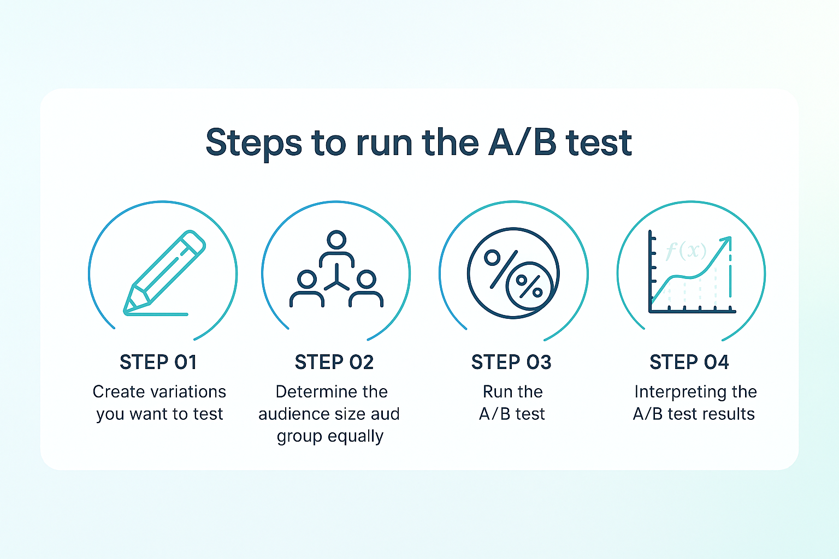

Slide 5
Simulating A/B Tests
- Use statistical models to predict outcomes
Monte Carlo simulations for confidence intervals
Simulate multiple scenarios before deployment

Slide 6
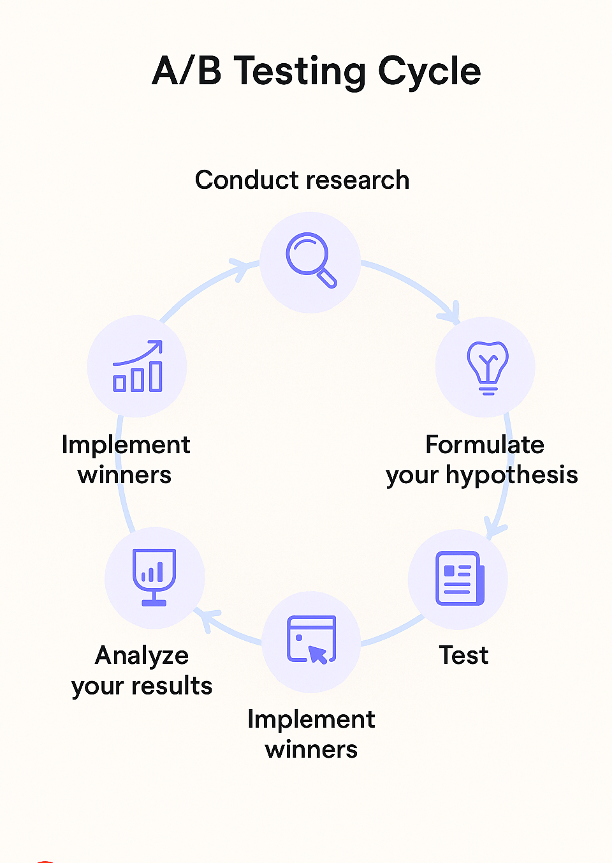

Slide 7
Evaluating A/B Test Results
Analyze conversion metrics
Use statistical significance (p-values)
Understand trade-offs and sample size

Slide 8
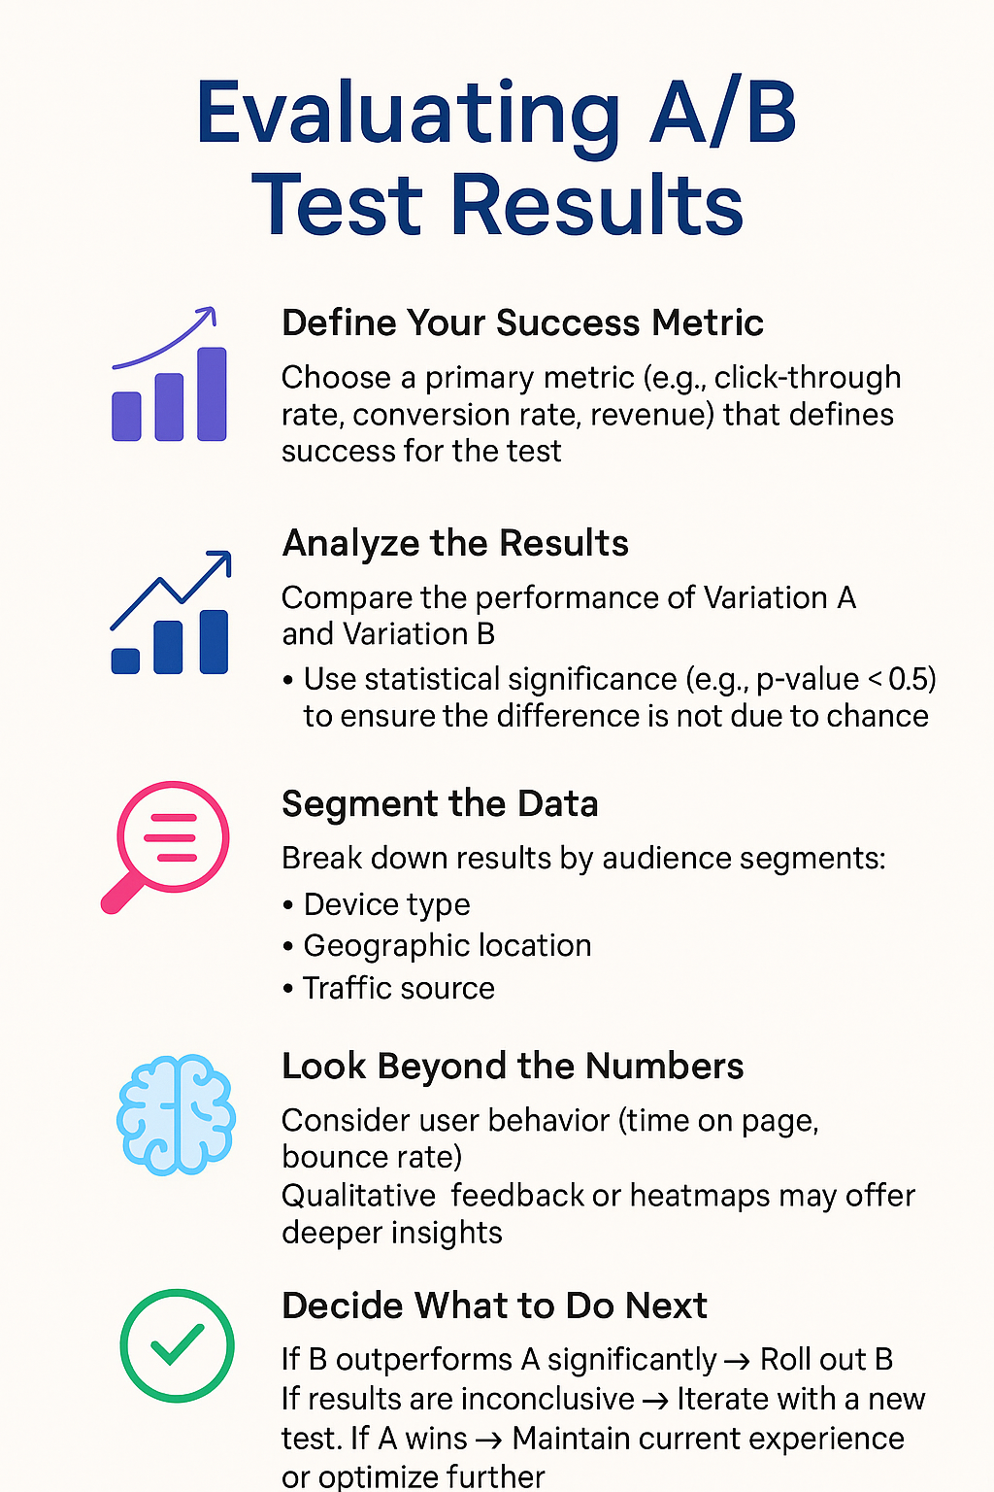

Slide 9
Example:
Website Button Color. Which button color gives more clicks?
Data Collected
Conversion Rate Formula
Conversion Rate=Clicks​/ Visitors
A = 120 / 1000 = 12%
B = 160 / 1000 = 16%
Version B performs better
Version | Button Color
A | Blue
B | Green
Version | Visitors | Clicks
A | 1000 | 120
B | 1000 | 160

Slide 10
What is Technical Debt?
Metaphor for shortcuts taken in code
Can lead to higher costs later
Types: Design, code, documentation, test

Slide 11
Refactoring Strategies
Improve structure without changing behavior
Types: Code cleanup, modularization
Tools: Linters, automated refactoring

Slide 12
MCQ
1 What is the primary goal of A/B testing?
A. Write code
B. Compare two versions
C. Refactor code
D. Test performance
2. What does a 'Control Group' represent?
A. New feature group
B. Original version
C. Test script
D. Debug tool
3. Which metric is commonly used in A/B testing?
A. Conversion Rate
B. Code Coverage
C. Bug Count
D. Cyclomatic Complexity

Slide 13
4. What is the benefit of simulating A/B tests?
A. Faster UI
B. Predict test reliability
C. Better CSS
D. Reduce RAM
5. What method is commonly used for simulation?
A. Newton's method
B. Monte Carlo
C. Refactoring
D. Control flow
6. Simulation helps in:
A. Deployment
B. Data deletion
C. Confidence interval estimation
D. Code duplication

Slide 14
7. A low p-value indicates:
A. Random data
B. High significance
C. Weak effect
D. No change
8. Larger sample sizes lead to:
A. More bias
B. Less cost
C. Greater accuracy
D. More noise
9. A/B testing helps in:
A. Code merging
B. Product decision making
C. Debugging
D. Logging

Slide 15
10. Technical debt is best described as:
A. Loan for hardware
B. Code complexity cost
C. New feature
D. Security patch
11. Which of these is a cause of technical debt?
A. Refactoring
B. Documentation
C. Rushed development
D. Testing
12. What is a consequence of ignoring tech debt?
A. Faster delivery
B. Reduced bugs
C. Poor maintainability
D. Lower memory

Slide 16
13. Refactoring is used to:
A. Break code
B. Improve code structure
C. Reduce internet use
D. Add bugs
14. Which tool helps in refactoring?
A. Browser
B. Linter
C. Compiler
D. OS
15. A good strategy to manage tech debt is:
A. Ignore it
B. Delay features
C. Prioritize refactoring
D. Increase meetings

